Slide 1

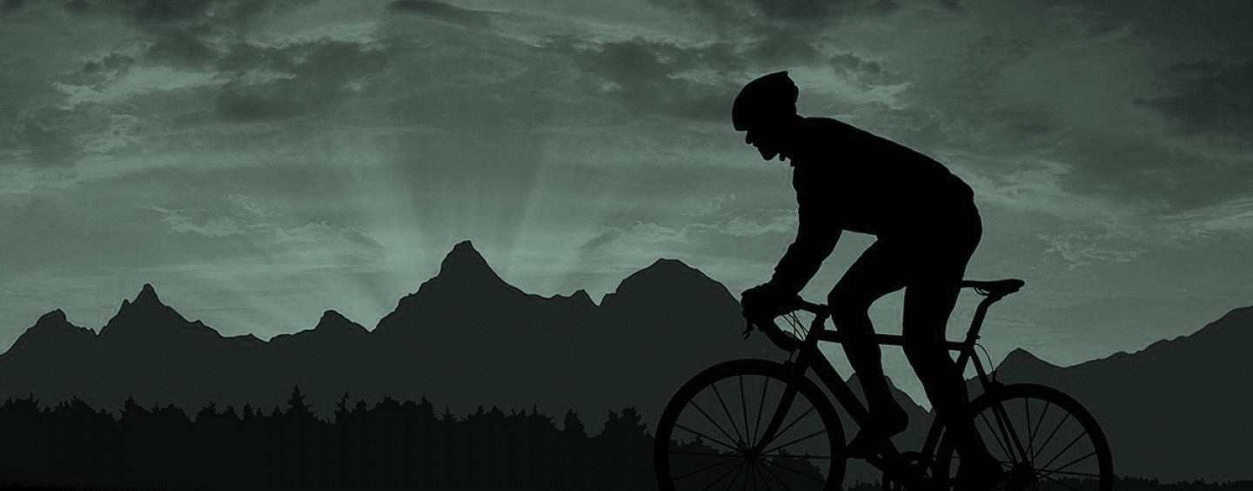
Timberhut
Social Network

Slide 2




Team members
Alonso Hernández
Elena Chávez
Alejandro Barbosa
Omar Saucedo

Slide 3



Why Timberhut?
Nowadays we have solutions to almost any daily problems, we can order anything within a click, we can see streaming content everywhere, but we have forgotten one of the main needs humans, which is stay healthy by physical activity.
Right now we have many options for physical activities as the typical sports, gyms, etc. But there's a field within sports that there's no diffusion, these are the Outdoor sports or Outdoor recreation

Slide 4
There's a field within sports that there's no diffusion, these are the Outdoor sports or Outdoor recreation, this section of sports is actually really important because besides that they have many goods as being fit, they offer you exclusive benefits as:
Being in contact with nature (flora and fauna)
Make community with other people
Nature's conscience and ecological responsibility

Slide 5
They challenge you not only physical but mentally too because of the constant changing environment
You get vitamin D which is really important for our bodies
Possibility to maintain our forests and green areas with government collaboration (natural reserves)
You don't need a membership

Slide 6
Objective
The main reason to develop this project is to make a positive impact to our community by being the bridge between outdoors sports and people, all with a responsible approach and always promoting good values and healthy habits.
Be the impulse that the growing Outdoors business area needs by making sponsorships and business covenants with the existing enterprises in the field.
We are not here to be a competitor, but to be the cluster of a growing and successful area as Outdoors is.

Slide 7
What is Timberhut?
This Project is a social network in which it is intended that fans of outdoor sports can share their experiences about the sports of their preference on the social network, in which they can share photos, tips and the location of the place that they are visiting
Notes:
Nowadays we see that outdoor sports is a sector which it is not being given much attention and in which we see potential business that will grow and which we want to be part of.

Slide 8





Applied Technologies
Notes:
Nowadays we see that outdoor sports is a sector which it is not being given much attention and in which we see potential business that will grow and which we want to be part of.

Slide 9






Applied Technologies
Notes:
Nowadays we see that outdoor sports is a sector which it is not being given much attention and in which we see potential business that will grow and which we want to be part of.

Slide 10
Impact
Creative way to solve a problem of the society
Share experiences
Be part of the impulse that the growing Outdoors business area needs

Slide 11
Demo
Notes:
Nowadays we see that outdoor sports is a sector which it is not being given much attention and in which we see potential business that will grow and which we want to be part of.

Slide 12
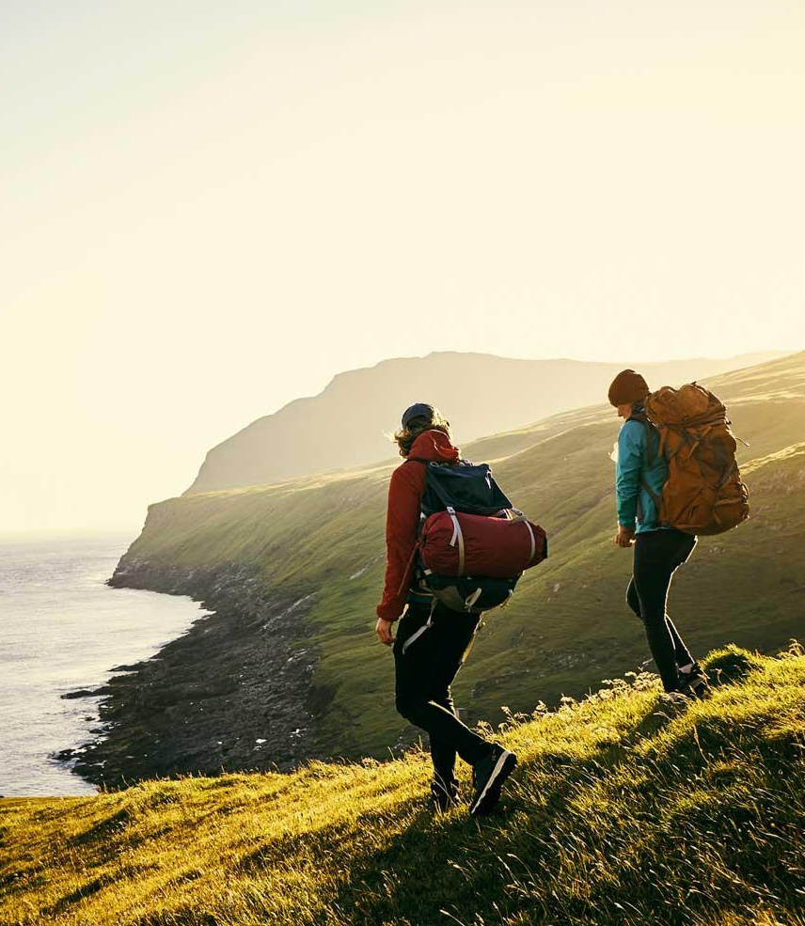
Thank you
timberhutenterprise@gmail.com

